Slide 1
User Analytics in the Telecommunication Industry- Overview
Analyzed By – Priyanka verma

Slide 2
Overview and required libraries
“Analyzing users’ experience, engagement and satisfaction to check for growth opportunities in TellCo and making recommendation on whether it is worth buying or selling.”
Environment – Python or Google Colab
Libraries –
import numpy as np
import pandas as pd
import seaborn as sns
import matplotlib.pyplot as plt
from sklearn.impute import SimpleImputer
from sklearn.preprocessing import OneHotEncoder, LabelEncoder
from scipy import stats
from scipy.stats import skew, norm
from sklearn.decomposition import PCA
from sklearn.preprocessing import StandardScaler
from sklearn.cluster import KMeans
from xgboost import XGBRegressor
from sklearn.ensemble import RandomForestRegressor, GradientBoostingRegressor

Slide 3
User Overview Analysis
Avg RTT DL (ms) and Avg RTT UL (ms): Average Round Trip Time measurement Downlink and Uplink direction in microseconds. Both are numerical features of type float.
Bearer TP DL (kbps) and Avg Bearer TP UL (kbps): Average Bearer Throughput for Downlink and uplink in kbps based on BDR duration. Both are numerical features of type float.
DL Retrans. Vol (Bytes) and TCP DL Retrans. Vol (Bytes): TCP volume of Downlink and Uplink packets detected as retransmitted in bytes. Both are numerical features of type float.
Handset Type: The handset type of the mobile device. It's a categorical feature of type object.
Handset Manufacturer: The handset manufacturer. It’s a categorical feature of type object.
Total DL (Bytes) and Total UL (Bytes): Total data volume in bytes received or sent during

Slide 4
USER OVERVIEW ANALYSIS
Top 10 most engaged users per application:
● After identifying top 10 most engaged users in the applications, the following appear in all 7 of them: 33625779332.0, 33614892860.0, 33626320676.0.
To replicate intense engagement in other customers like the 3, the following can be considered:
– Extending the unique features of the Handset types used by the 3 to other handsets.
– Increasing the stock of the handsets used by the 3 to force customers into buying them.
The above recommendations assumes the highest contributor towards a user’s engagement with all the applications is the handset type.
There are other factors that contribute to this, ex:- User’s interests, most which are tailored to each user, but based on the data provided , Handset Type is the most reasonable contributor

Slide 5
:
The data provided has numerous features but not all are worth exploring. The following are some of the relevant features:
Bearer Id: The xDR session identifier. It’s a categorical feature.
Dur. (ms).1: This represents the session duration in microseconds. It’s a numerical feature
MSISDN/Number: This is the unique customer identifier(number). It’s numerical but can be treated as a categorical feature due to it’s uniqueness to each customer.
Social Media DL (Bytes) and Social Media UL (Bytes): Social media data volume in bytes received and sent respectively during the session. Its a numerical feature of type float.
NB: ** The description above extends to the following features: YouTube DL (Bytes), YouTube UL (Bytes), Netflix DL (Bytes), Netflix UL (Bytes), Google DL (Bytes), Google UL (Bytes), Email DL (Bytes), Email UL (Bytes), Gaming DL (Bytes), Gaming UL (Bytes), Other DL, Other UL
The only difference is in the application type
Relevant Features

Slide 6
The following metrics will be used for the analysis
User engagement :
User experience:
User satisfaction
This is calculated as the shortest distance between an observation and a cluster centroid of the least engaged cluster. The clusters will be generated from performing a KMeans cluster analysis on the sessions duration, sessions traffic and sessions frequency aggregated per customer. This metric will give a picture of how intense a customer’s engagement with various services is and thus provide directions on what services and products to put more effort towards in order to increase the engagement further and encourage more customers.
The metric is calculated the same way as user engagement, only that the KMeans analysis is performed on the average TCP transmission, average RTT, average throughput and handset-type count aggregated per user. This will help in the optimization of products and services so that it meets the evolving users needs and expectations.
Satisfaction is calculated as the average of a user’s engagement and experience scores. This will give an overall view of a user’s satisfaction in all aspects. Most satisfied users’ behaviors' can be observed and the services and products contributing to the set of behavior's be given a higher priority and the insignificant ones be rid off or improved.

Slide 7
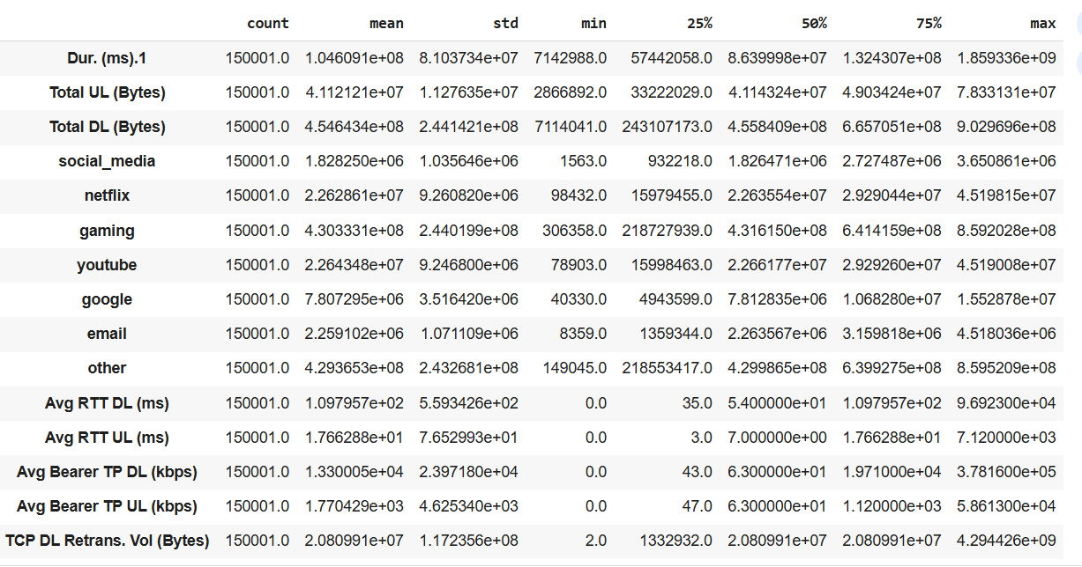
User overview Analysis
Non graphical Univariate Analysis

Slide 8
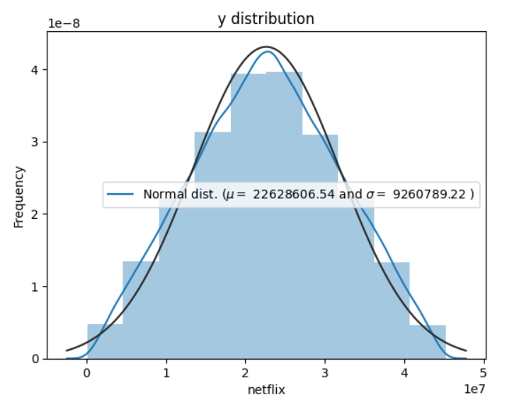
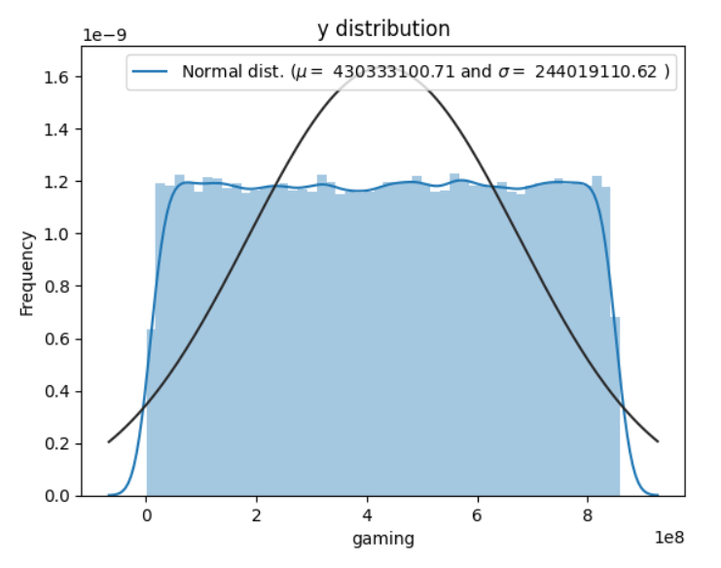
Graphical UNIVARIATE ANALYSIS
The plot of Netflix for session duration’s symmetric bell shaped indicating Normally distributed unimodal .Its mean 22628606 and std is 9260789.22 which matches the non- graphical analysis.
The Gmming plot is uniformly shaped indicating consistent uniformly distributed data with a mean of 430333100 and a standard deviation of 244019110 matching the non-graphical analysis.

Slide 9
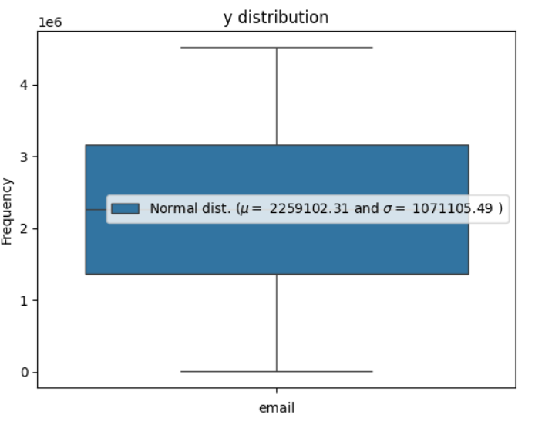
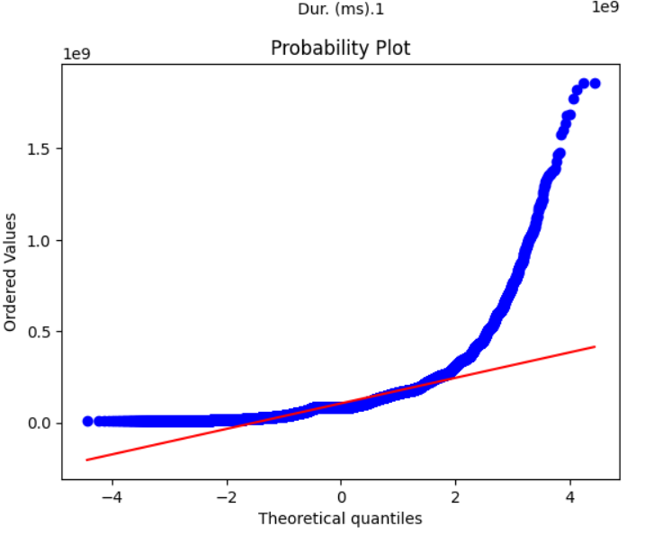
Graphical univariate analysis
The box plot is symmetrical (median splitting the plot equally) indicating unimodal normally distributed data with a mean of 2259102 and standard deviation of 1071105 bytes.
A qqplot indicating heavily skewed right-tailed normal distribution.

Slide 10
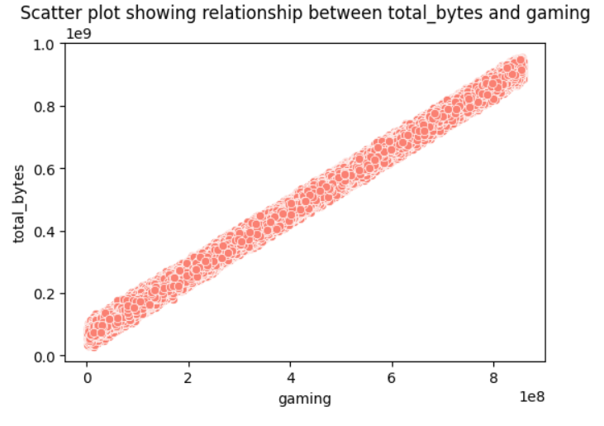
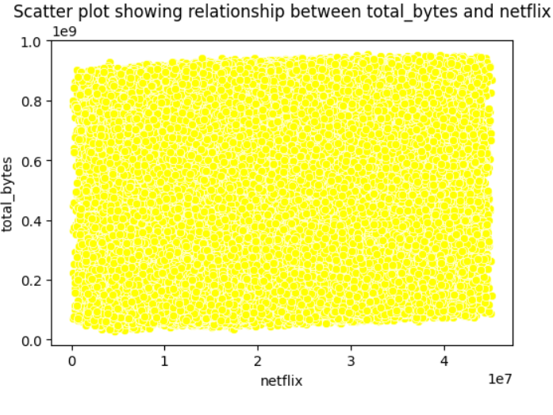
Bivariate Analysis between the apps and the total bytes
* Correlation is a measure of the strength of a linear relationship between two quantitative variable
# Positive correlation between gaming and total bytes. Could be as a result of .
# correlation between Netflix and total bytes. For the remaining applications: Email, Youtube, Google, Other and Social media, the plots resemble the Netflix plot indicating no correlation between the applications and the total bytes.

Slide 11
User overview analysis
*The plots in the previous slides show the unique distribution shapes obtained from the features.
*Summary of the distributions of the remaining features :–
#Google: Unimodal normally distributed data.
#Social media: Multimodal uniformly distributed data.–
# Total bytes: Multimodal uniformly distributed data
# Total RTT: Right skewed normally distributed data.
#Total TCP: Right skewed normally distributed data.
#Youtube: A symmetrical bell-shaped plot indicating normally distributed data.
# Total Throughput: A plot indicating right-tailed unimodal normally distributed data. A *Normal distribution indicates that in a particular feature, majority of the observations are near the mean.
*Uniform distribution indicates equal outcome of all observations in a particular feature

Slide 12
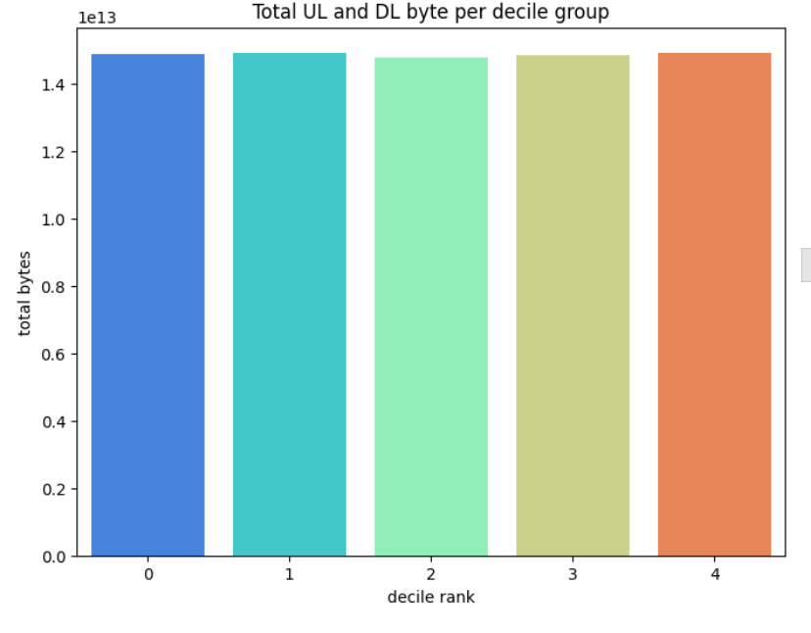
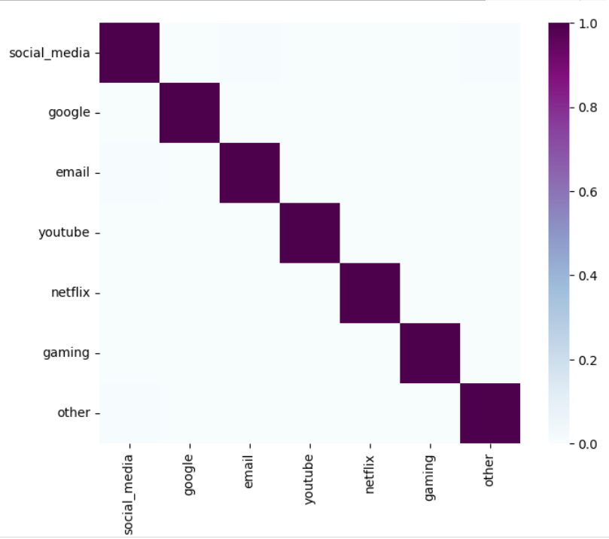
USER OVERVIEW ANALYSIS
*VARIABLE TRANSFORMATION : The plot below shows total data per Decile class . The classes are generated based on the total session duration .
# The total bytes is the same across the decile groups , this indicates that –
# The amount of total bytes is independent of session duration.
# If explanation one is incorrect, then the variation of session
duration across the decile groups is minimal.
* CORRELATION : The Heatmap shows that the applications have no
Correlation with each others

Slide 13
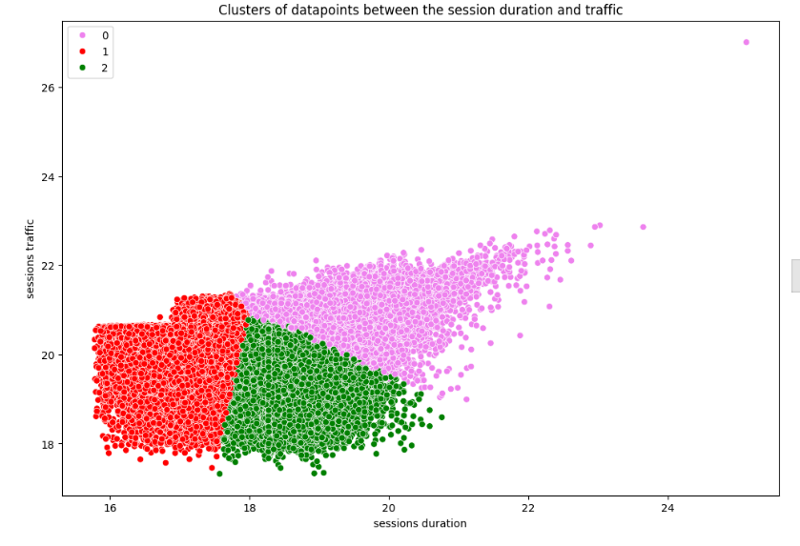
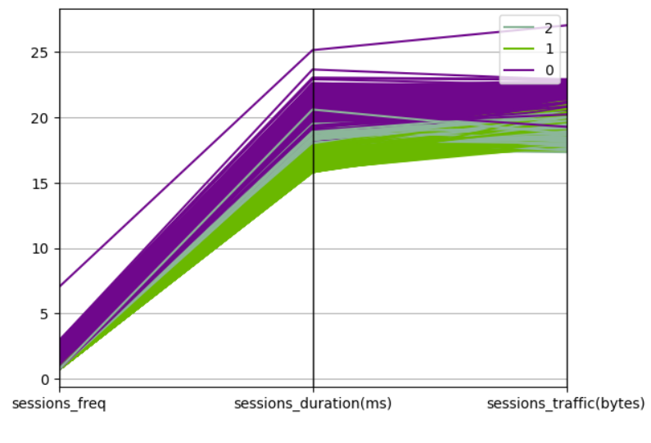
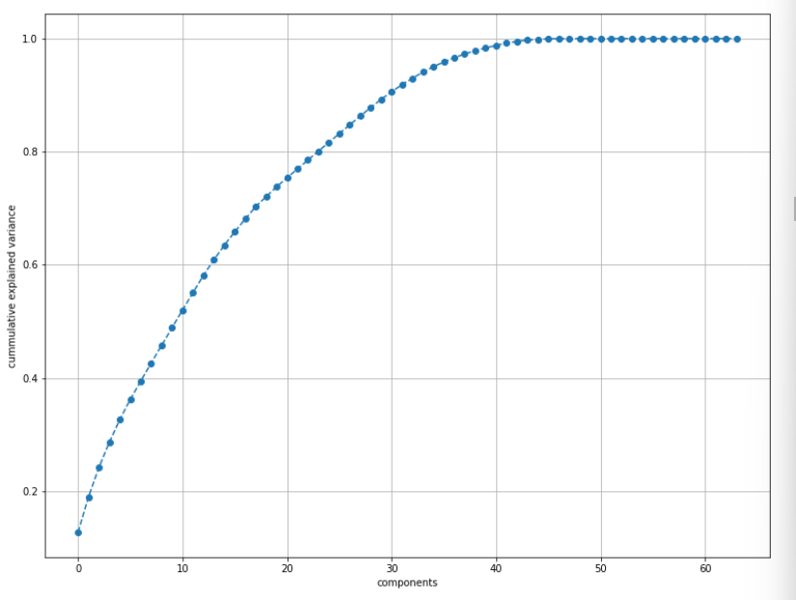
USER ENGAGMENT ANALYSIS
3D VIEW OF
CLUSTERS
Dimensionality Reduction: : Cumulative graph is explaining the optimal number of components(features)to be 23 after considering 80% cumulative variance coverage rule.
# This is the massive reduction from the original features.
# 10 users with the highest number of sessions, highest sessions traffic and longest sessions duration:
After identifying top 10 users in each of the 3 categories, the following appear in all the 3: 33625779332.0, 33626320676.0, 33760413819.0, 33614892860.0, 33760536639.0 The products and services used by the 5 users that appears in the 3 categories can be identified and their special

Slide 14
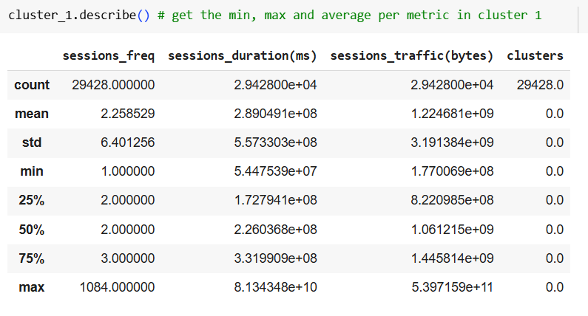
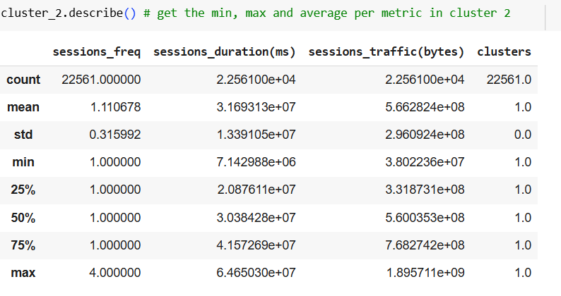
user engagement analysis
A summary of clusters generated from performing a KMeans analysis on the users based on the sessions count, sessions duration and sessions traffic.
Session frequency: The minimum values are the same across the clusters since 1 is the least possible value of session frequency. The maximum values vary with the highest session frequency falling under cluster 2. The average values also vary depending on the values of the sessions-frequency under each cluster
Sessions Duration: The minimum values have a slight variation across the clusters. The maximum values’ variation is a bit wider, with the highest value falling under cluster 2. This could be due to the presence of the highest session-frequency in the cluster assuming correlation between sessions frequency and duration. The same explanation extends to the mean values.
Sessions Traffic: The behavior observed in the sessions duration is replicated in sessions traffic too. The explanation stands: the values in cluster 2 are overlay higher than those in 1 and 3 due to the presence of the highest session-frequency value in the cluster assuming a correlation between sessions frequency and sessions traffic. User engagement analysis Top 10 most engaged users per application: ● After identifying top 10 most engaged users in the applications, the following app.

Slide 15
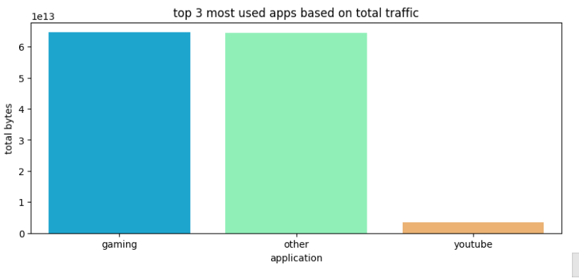
USER ENGAGEMENT ANAYSIS
Top 3 most used applications based on sessions total traffic
# The large percentage of the ‘other’ application can be explained by the many minor applications being represented by the one column. As for ‘gaming’, it could be due to the following reasons:
– Most of the gaming applications consume a lot of bytes compared to other applications
– The games have a bigger percentage in the total applications available in a handset.
– Most of the handset users are could be gamers

Slide 16
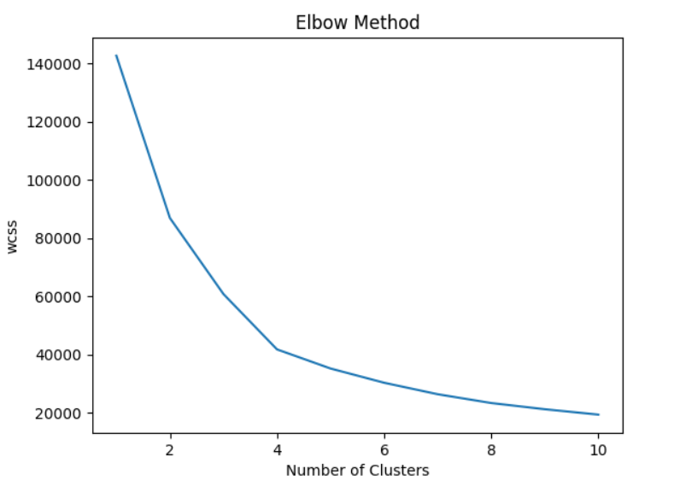
USER ENGAGEMENT ANALYSIS
Optimized number of clusters= 4 based on the elbow plot are below
Clusters 4 has the highest number of users with an average total sessions duration, average total sessions traffic and an average of 1 xDR session per user.
Clusters 3 has the 2nd highest number of users with the highest total sessions duration, highest total sessions traffic and an average of 2 xDR sessions per user.
Clusters 2 has the 2nd lowest number of users with the lowest total sessions duration, average total sessions traffic and an average of 1 xDR sessions per user.
Clusters 1 has the lowest number of users with an average total sessions duration, average total sessions traffic and an average of 1 xDR sessions per user.

Slide 17
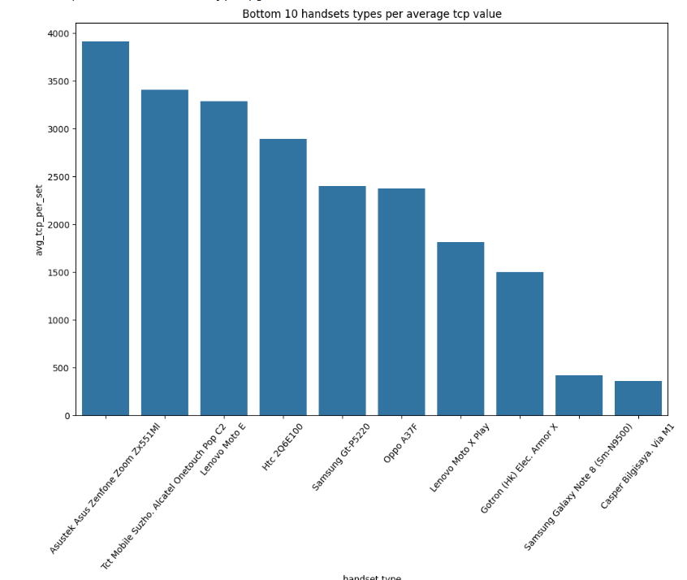
USER EXPERIENCE ANALYSIS
#Throuput distribution: The variable is right-skewed unimodal normally distributed with a mean of 12400 and standard deviation of 14661.
#Average TCP retransmission per handset type. ●
- TCP retransmission is an indication of reliable sending of data from end to end.
- The plot below shows that 60% of the handsets with the highest TCP retransmission average values are manufactured by the top 3 handset manufacturers

Slide 18
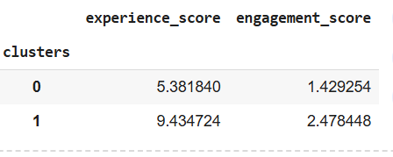
USER Experience ANALYSIS
Clusters description on the experience metrics (Total TCP, Total RTT and Total Throughput). ● ● ●
● Cluster 1 has the highest number of users. Thus, on average, most users have 1 type of handset, overall low throughput values, low RTT values and medium TCP values.
Cluster 2 is the 2nd most populated cluster. On average, users have 2 types of handsets, high RTT values, high throughput values and high TCP values.
Cluster 3 is the least populated. Users in this cluster have on average: 1 type of handset, low TCP values, medium RTT values and medium throughput values. Average experience and engagement scores per cluster. Cluster 0 has users with lower experience and engagement score compared to cluster 1. As a result, the
Cluster 0 has users with lower experience and engagement score compared to cluster 1. As a result, the satisfaction score will be lower in cluster 0 .

Slide 19
USER EXPERIENCE ANALYSIS
#10 of the top, bottom and most frequent tcp, rtt and tp values in the dataset. #There’s a variation in the top, bottom and frequent values across the 3 features.
#The variation is due to different units of measurement and the different aspects each feature represents.
#The most frequent values in RTT and TP are generally low values unlike frequent TCP values.
The gap between the top and bottom values across the 3 features is extremely large. This can mean the following:– If the values are dependent on the handset type, then there are extremely poor performers in the handsets the company stocks.– If the values are dependent on user engagement with the applications, then there are extremely less active customers.
. The problem with poor performing devices can be fixed by reducing their stock and increasing the excellent performers. This will result into either forcing users into buying the excellent performers or looking for other companies. The less user engagement problem can be fixed by either introducing devices with more applications if it’s an issue of interest or spotting the apps with at least a high engagement among these users and adding more features to them

Slide 20



